Slide 1
COSE471(02); Spring quarter, 2017
Word2Vec을 기반으로 한
Text Understanding

Slide 2
Introduction
팀원:
2012210106 박찬혁
2014210097 박준형
모델:
Skip-gram with hierarchical softmax
언어:
C/C++, Python3
데이터파일:
text8

Slide 3
Word2Vec

Slide 4
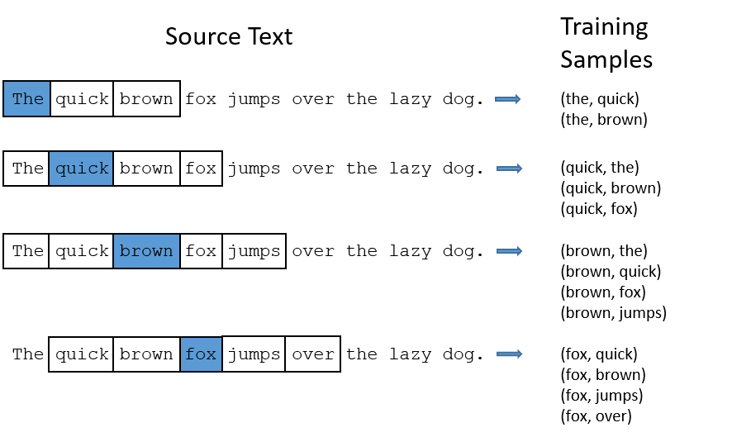
Word2Vec
- Training Sample

Slide 5
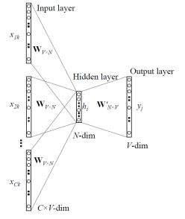
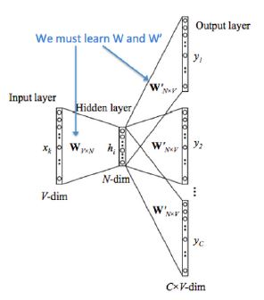
Word2Vec
- Model

Slide 6
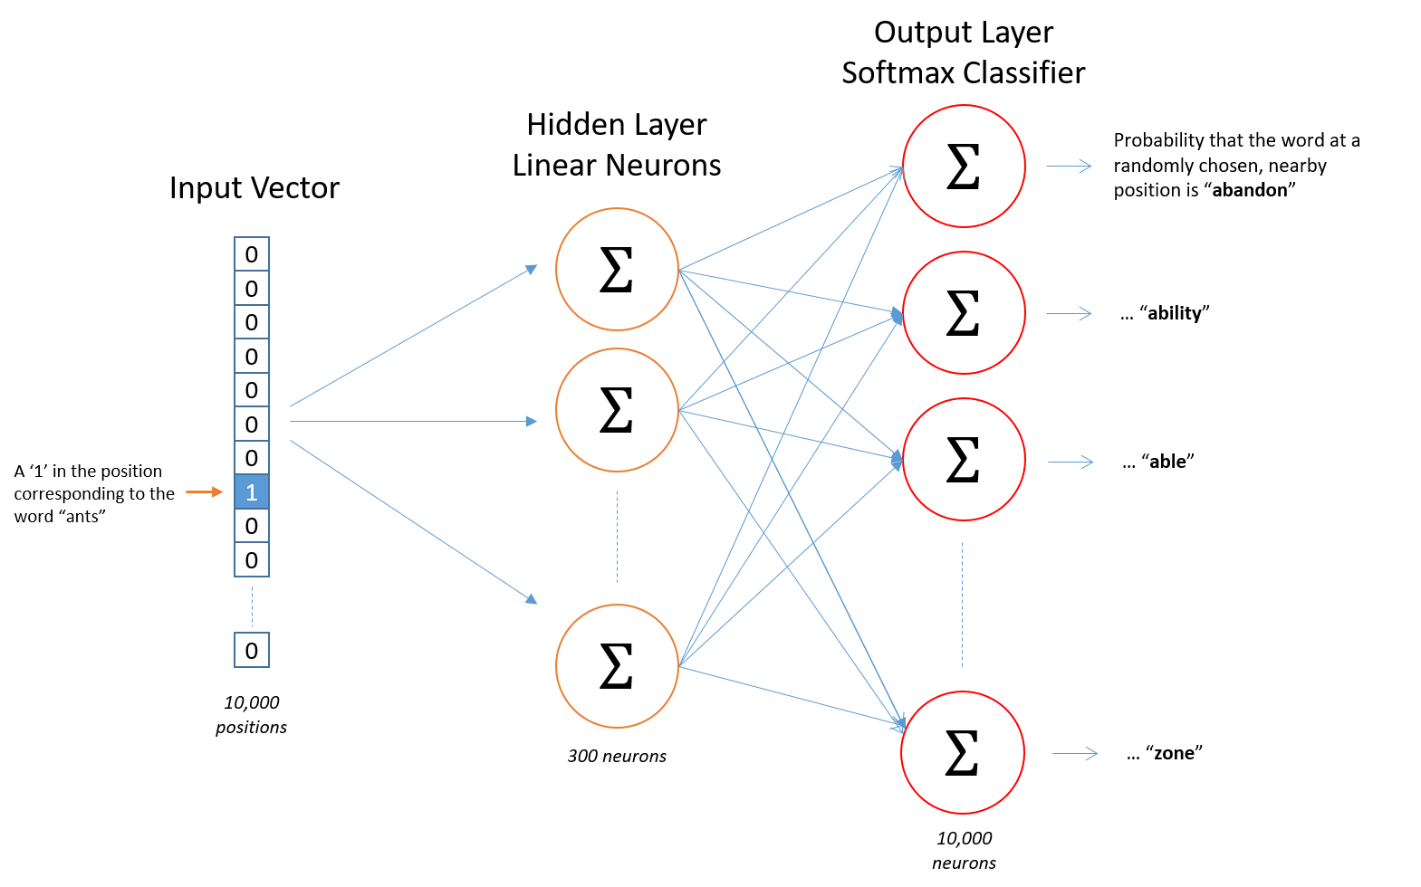
Word2Vec
- Layer

Slide 7






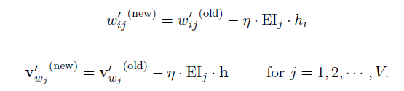
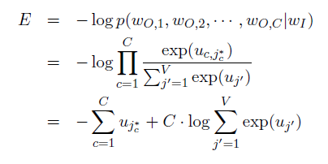


Word2Vec
- Learning algorithm

Slide 8
Optimizing

Slide 9
Optimizing
Input Filtering
-> 스탑워드 제거하고 적은 단어 제거

Slide 10
Optimizing
- Hierarchical Softmax

Slide 11
Optimizing
- Negative Sampling

Slide 12
Optimizing
- Code Optimizing
스탑워드 제거하고

Slide 13
Repository
https://github.com/pch8944/DS_Word2Vec

Slide 14
Project

Slide 15
Project
Implicit Represent

Slide 16
Project
Explicit Represent

Slide 17
Project
Plan

Slide 18
Project
Why?

Slide 19
Project
Progress

Slide 20
참고문헌
논문1
논문2
http://mccormickml.com/2016/04/19/word2vec-tutorial-the-skip-gram-model/
https://code.google.com/archive/p/word2vec/

